Slide 1

Virtual Reality Sickness Mitigation Methods: A Comparative Study in a Racing Game
Rongkai Shi, Hai-Ning Liang, Yu Wu, Difeng Yu, Wenge Xu

Slide 2
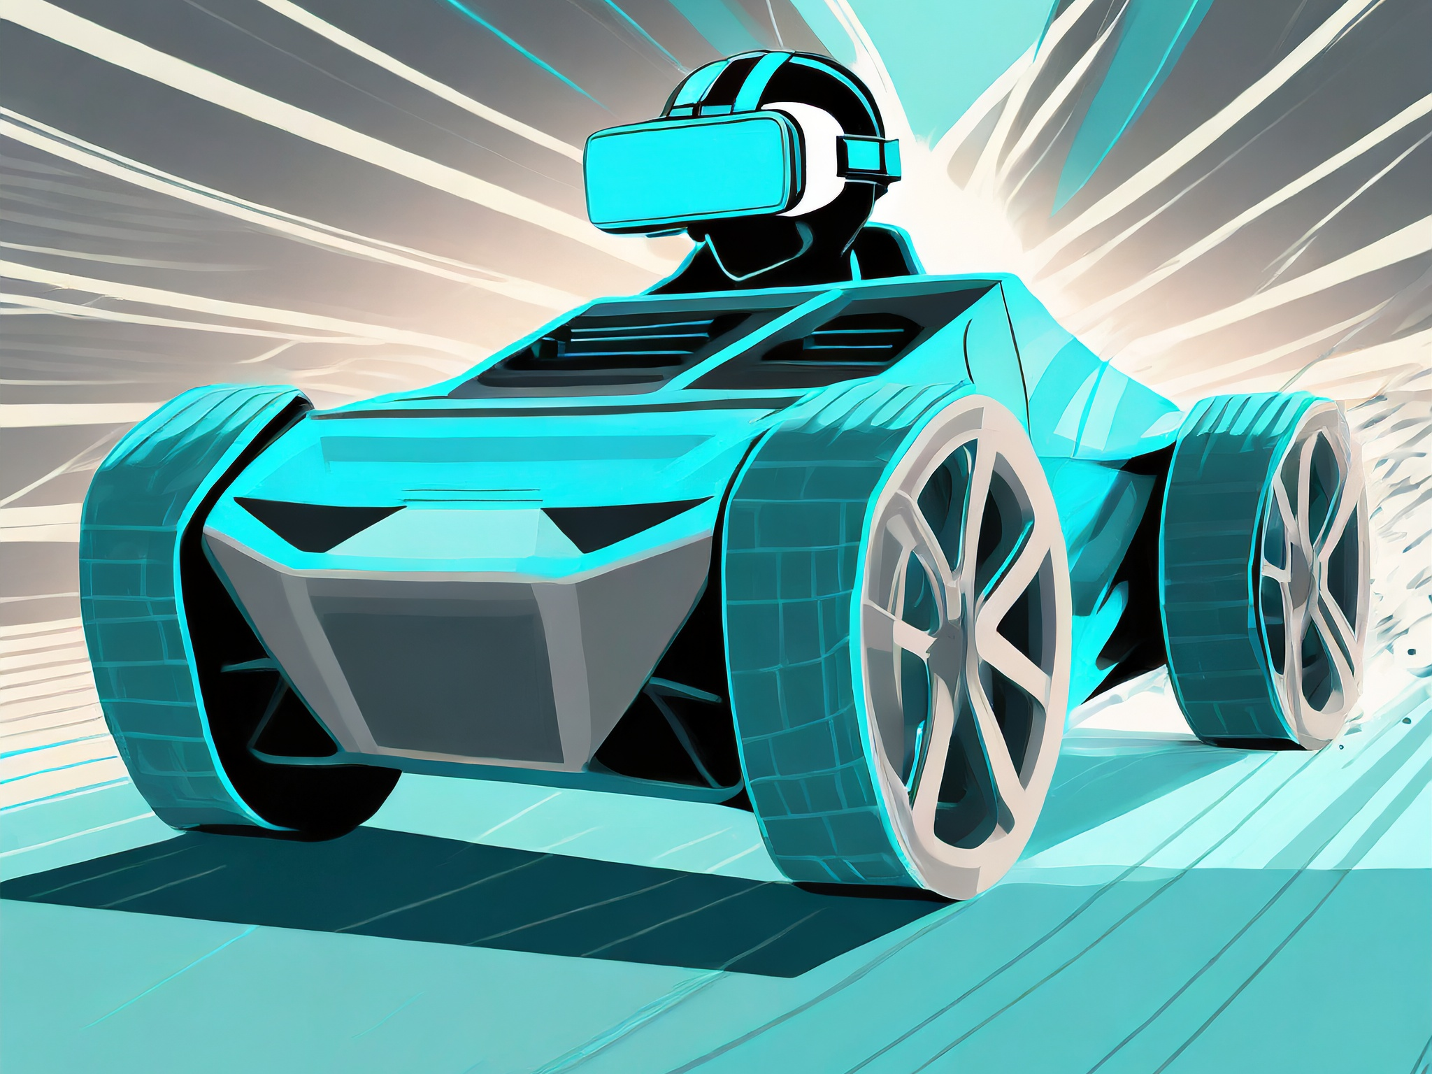
Introduction
Key Focus: The paper discusses Virtual Reality (VR) Head-Mounted Displays (HMDs) and their immersive virtual environments, particularly in gaming.
Problem Statement: VR sickness, also known as cybersickness or virtual reality induced motion sickness (VRIMS), is a significant issue in VR experiences. It includes symptoms like eye strain, headache, nausea, and disorientation, which can detract from the VR experience.

Slide 3
Motivation
Prevalence of VR Sickness: High incidence of VR sickness among users, affecting their health, duration of VR experience, presence, enjoyment, and performance in various environments, particularly in games.
The motivation behind this research was to explore and compare various methods for mitigating Virtual Reality (VR) sickness. VR sickness, characterized by symptoms like nausea and disorientation, can significantly hinder the VR experience, especially in dynamic environments like racing games.

Slide 4
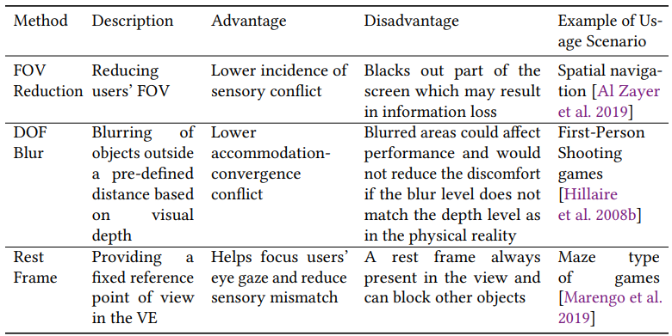
Summary of Mitigation Techniques used in Study

Slide 5
Purpose of this study
To systematically evaluate and compare the relative effects of these VR sickness mitigation techniques on VR sickness, presence, workload in task completion, and information loss in a VR racing game with two levels of control.

Slide 6
Background and Related Work
Prior research has explored various VR sickness mitigation methods, primarily focusing on visual adjustments within the VR environment. These include techniques like Field of View (FOV) reduction, Depth of Field (DOF) blurring, and the addition of rest frames. This paper builds on this existing knowledge by systematically comparing these methods in a VR racing game context.

Slide 7
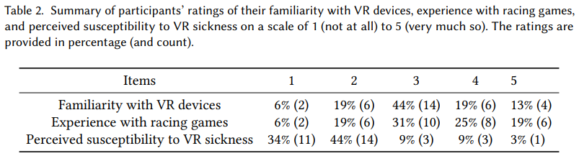
User Study
Participants: 32 unpaid university students (4 females), aged 18-24, mean age 19.56.

Slide 8
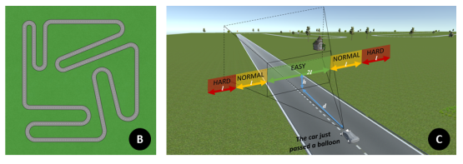
Methodology
Virtual Environment: racetrack with 8 right turns and 4 left turns, 57 pairs of arrow signs, 12 directional signs placed by the roadside to warn them of any upcoming turns, guardrails, and objects like grass, trees, and wooden Houses to make the virtual scene more realistic.

Slide 9
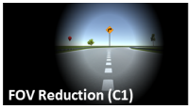
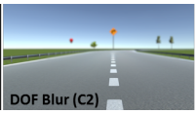
Methodology
Task: Participants had to find and confirm the sighting of 60 red balloons placed at varying heights and distances.
FOV Reduction (C1): DOF Blur (C2):

Slide 10
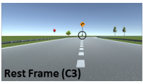
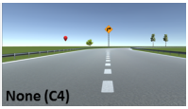
Methodology
Rest Frame (C3):
None (C4):
Study Design: 2 × 4 mixed factorial design. Control (High or Low degree of control) as a between-subjects factor and Techniques as within-subjects.
Procedure: Participants completed tasks in each condition, with a practice session beforehand. Trials lasted around 5 minutes each, with breaks between sessions.

Slide 11
Hypotheses
This user study is aimed at verifying the following hypotheses that are derived from the literature:
• H1: Participants will have more VR sickness in LDoC than in HDoC.
• H2: The techniques applied in C1, C2, and C3 will reduce the VR sickness compared to the baseline (C4).
• H3: Participants will have less sense of presence in VE in C1, C2, and C3 compared to in C4.
• H4: There will be less information loss in C4 than in the other three conditions.

Slide 12
Results
Simulator Sickness Questionnaire (SSQ):
- No significant interaction between Technique and Control across all SSQ measures (Nausea, Oculomotor, Disorientation, Total Severity).
- Notable result: Only significant difference in Disorientation (SSQ-D) between C2 (DOF Blur) and C3 (Rest Frame).
Presence and Workload:
Slater-Usoh-Steed Presence Questionnaire (PQ) and NASA TLX Questionnaire showed no significant interaction or main effects of Technique and Control. This suggests consistent presence and workload perceptions across all conditions.

Slide 13
Results
Information Loss (Balloon Task):
-Significant effects of Technique condition on the number of balloons confirmed, missed, or unseen across different difficulty levels.
-The interaction effect between Technique and Control was significant only in the number of missed balloons in the Normal(level 2) difficulty level.
-Correlation studies revealed a significant relationship between perceived susceptibility to VR sickness and the number of balloons confirmed in HDoC.
Completion Time and Collisions:
No significant differences in completion time and number of collisions among the four Technique conditions in HDoC.

Slide 14
Result Conclusion
The key findings were that there were no significant differences in VR sickness, presence, and workload among the techniques and control levels. However, both FOV reduction and DOF blurring resulted in some degree of information loss. The study suggests that frequent FOV changes and inappropriate DOF blurring levels can increase discomfort.

Slide 15
Results Discussion
VR Sickness and Techniques: FOV reduction, DOF blur, and rest frame (target reticule) were not effective in significantly reducing VR sickness in high-speed VR scenarios like racing games. This contrasts with previous studies that showed positive effects in different contexts.
FOV Reduction: Participants experienced discomfort and disorientation, especially with frequent changes in FOV. This suggests that dynamic FOV reduction might not be suitable in environments with rapid motion changes.
DOF Blur: Increased discomfort reported, likely due to inappropriate blur levels. This highlights the need for careful calibration of DOF blur effects.
Rest Frame (Target Reticule): Limited impact on reducing VR sickness in the fast-paced gaming environment.

Slide 16
Results Discussion
Presence and Workload: No significant differences in presence or workload across all conditions, suggesting these factors were stable irrespective of the mitigation technique used.
Information Loss: Significant findings regarding information loss, particularly with FOV reduction and DOF blur techniques. FOV reduction led to unseen balloons, while DOF blur caused difficulty in identifying balloons.

Slide 17
Discussion
The results are significant as they suggest that while these methods can mitigate VR sickness to some extent, they also have drawbacks like information loss.
A limitation of the study is its focus on a single user group, which might not represent the broader range of VR users.

Slide 18
Group Conversation
What are your thoughts on why certain VR sickness mitigation techniques like FOV reduction and DOF blur weren't as effective in a high-speed VR environment?
Can these techniques be modified for better effectiveness, or should new methods be explored?
How can these findings be applied in different VR scenarios?
In what ways can developers balance the trade-off between reducing VR sickness and maintaining the quality of the VR experience?
What about using electroencephalography (EEG)?

Slide 19
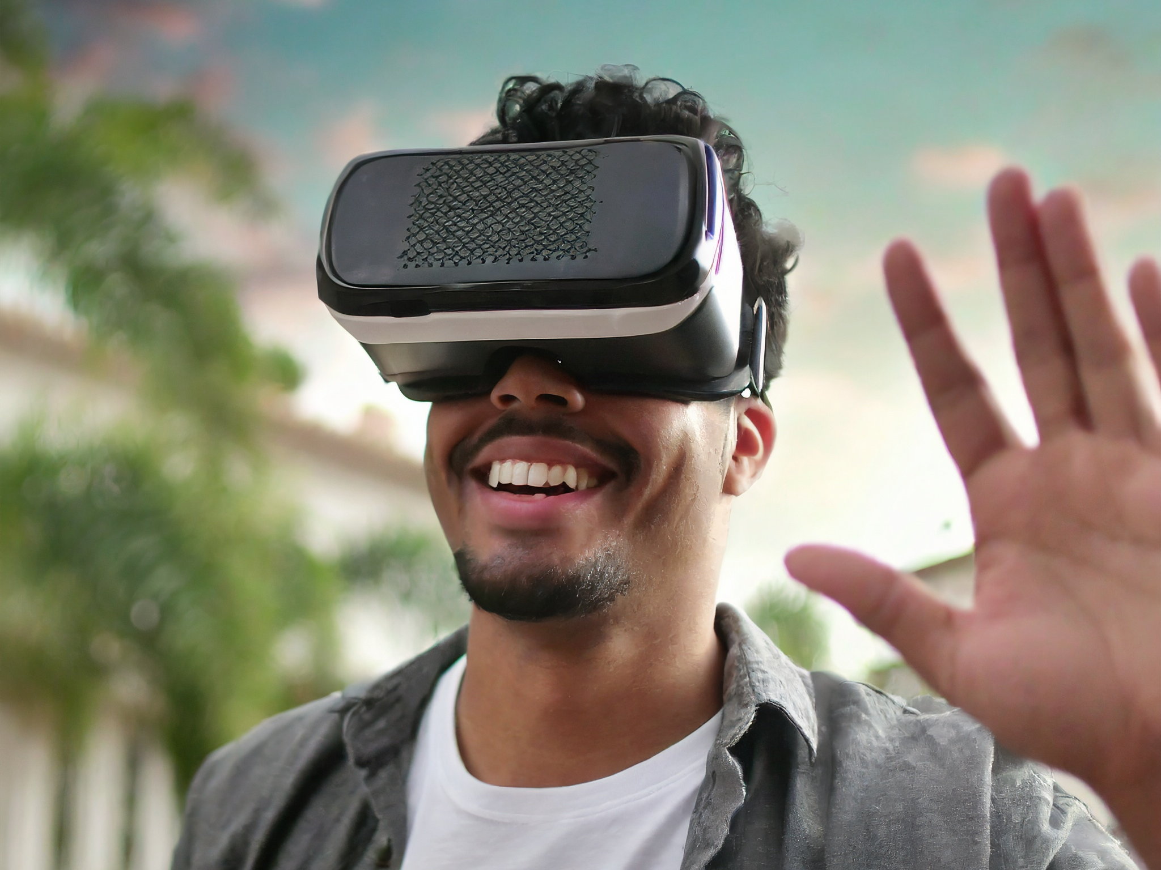
Thank you!

